Slide 1
Unit 2 DB2 and SQL

Slide 2
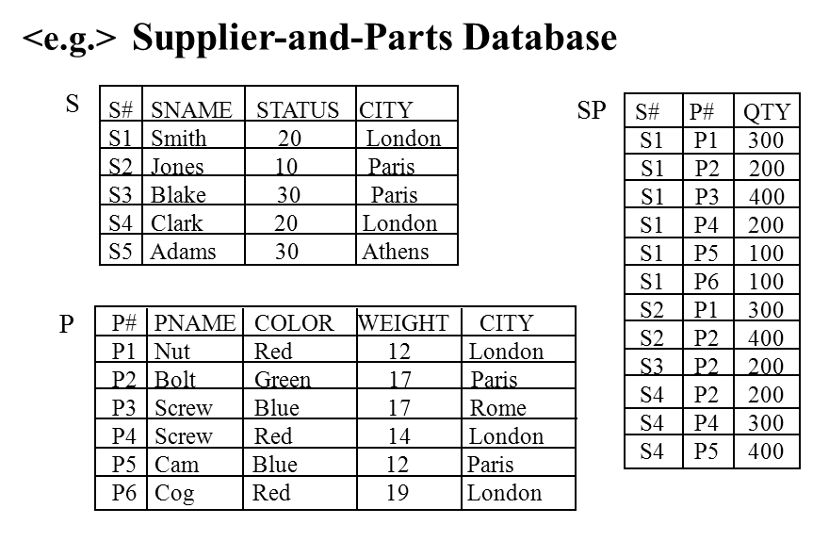
Outline of Unit 2
2.1 Overview DB2
2.2 Data Definition
2.3 Data Manipulation
2.4 The System Catalog
2.5 Embedded SQL
2.6 實作範例

Slide 3
2.1 Overview DB2

Slide 4
Background
Relational Model: proposed by Codd, 1970
Ref: A Relational Model of Data for Large Shared Data Banks, CACM, 13(6):377-387, June 1970.
 | System R | INGRES
Developer | IBM San Jose Res. Lab 1974 - 1979 | UC Berkeley late 1970 - early 1980
Machine | IBM System 370 | DEC PDP
O. S. | VM / CMS | UNIX
Query Language | SQL | QUEL
Language Embedded | COBOL or PL/1 | COBOL, PASCAL, C FORTRAN, BASIC
Commercial Product | DB2, SQL / DS | Commercial INGRES
Distributed OB | R* | Distributed INGRES
OO Extension | Starburst | POSTGRES

Slide 5
Relational Databases
Definition: A Relational Database is a database that is perceived by its users as a collection of tables (and nothing but tables).
<e.g.> Supplier-and-Parts Database
S
S# SNAME STATUS CITY
S1 Smith 20 London
S2 Jones 10 Paris
S3 Blake 30 Paris
S4 Clark 20 London
S5 Adams 30 Athens
SP
S# P# QTY
S1 P1 300
S1 P2 200
S1 P3 400
S1 P4 200
S1 P5 100
S1 P6 100
S2 P1 300
S2 P2 400
S3 P2 200
S4 P2 200
S4 P4 300
S4 P5 400
(Hierarchical Model)
IMS
vs.
P
P# PNAME COLOR WEIGHT CITY
P1 Nut Red 12 London
P2 Bolt Green 17 Paris
P3 Screw Blue 17 Rome
P4 Screw Red 14 London
P5 Cam Blue 12 Paris
P6 Cog Red 19 London

Slide 6
Relational Databases (cont.)
S, P, SP: 3 relations (tables)
A row in a relation is called a tuple (record)
S, P: entities; SP: relationship
primary key: S# in S, P# in P, (S#, P#) in SP
atomic: not a set of values, instead of repeating group
< e.g. > S# P#
---------------------------------------------------
S1 { P1, P2, P3, P4, P5, P6 }
S2 { P1, P2 }
. .
. .
. .
S
P
P# PNAME COLOR WEIGHT CITY
P1 Nut Red 12 London
P2 Bolt Green 17 Paris
P3 Screw Blue 17 Rome
P4 Screw Red 14 London
P5 Cam Blue 12 Paris
P6 Cog Red 19 London
SP
S# P# QTY
S1 P1 300
S1 P2 200
S1 P3 400
S1 P4 200
S1 P5 100
S1 P6 100
S2 P1 300
S2 P2 400
S3 P2 200
S4 P2 200
S4 P4 300
S4 P5 400
S# SNAME STATUS CITY
S1 Smith 20 London
S2 Jones 10 Paris
S3 Blake 30 Paris
S4 Clark 20 London
S5 Adams 30 Athens
atomic
Normalization

Slide 7
Major System Components: DB2
1. Pre-compiled
2. Bind
3. Runtime Supervisor
4. Data Manager
5. Buffer Manager
PL/I + SQL:(P.2- 46)
EXEC SQL CREATE TABLE S ( S# CHAR(5), ......)
EXEC SQL SELECT SNAME INTO :SNAME FROM S
IF SQLCODE < 0 THEN .......
Source
Module
CALL CREATE( ......)
CALL SELECT( ......)
IF SQLCODE < 0 THEN
.......
Modified
Source
Module
Pre-compiler
DBRM
request
module
parse-tree version
of SQL
PL/I source
PL/I-Compiler
Bind
a DB Compiler
Object
Module
Application
Plan
optimized machine
codes of SQL statements
in system Catalog
Linkage
Editor
(Load Module)
(Application Plan)
Runtime Supervisor
Data Manager
Buffer Manager
(Other)
2
3
1st time
3'
Load
Module
1
4
DB

Slide 8
Major System Components: Execution time
Execution time
PL / 1 LOAD MODULE P
If -
-
CALL
-
Runtime
Supervisor
Catalog
or Dictionary
"data about data"
Application
Plan
( for P )
(Ref. p. 2-34)
Stored
Data
Manager
Buffer
Manager
Database
"data"

Slide 9
Major System Components: Optimizer
Plan 1 (without index): SCAN S
if S # = 'S4’ then extract name field
go to SCAN S
.
.
.
Plan 2 (with sorted index): Binary Search X
if X.key = 'S4‘ then ..........
Be chosen by optimizer (Ref. p. 2-34)
Considerations :
1. Which table ?
2. How big ?
3. What index exist ?
.
.
.
DBRM
Application
Plan 1
SELECT SNAME
INTO SNAME
FROM S
WHERE S# = 'S4'
BIND
OPTIMIZER
Application
Plan 2
X: S#_index
s1
S#
s2
.
.
.

Slide 10
2.2 Data Definition

Slide 11
DDL of SQL
Base Table
Create Table
Drop Table
Alter Table
Index
Create Index
Clustering Index
Drop Index
View
Create View
Drop View

Slide 12
Base Tables
A named table
<e.g. 1> CREATE TABLE S
(S# CHAR (5) NOT NULL,
SNAME CHAR (20),
STATUS SMALLINT,
CITY CHAR (15));
Data can be entered by
(1) INSERT statement
(2) DB2 load utility
<e.g. 2> ALTER TABLE S
ADD DISC SMALLINT;
<e.g. 3> DROP S ;
Description of S is removed from system catalog.
All index and views defined on S are automatically dropped.
S
S# SNAME STATUS CITY
S
S# SNAME STATUS CITY DISC

Slide 13
Base Tables (cont.)
FOREIGN KEY
FOREIGN KEY (column-commalist )
REFERENCES base-table [(column-commalist )]
[ON DELETE option]
[ON UPDATE option]
CHECK
CHECK (conditional-expression)
<e.g.> : CREATE TABLE SP
( S# S# NOT NULL, P# P# NOT NULL, QTY QTY NOT NULL,
PRIMARY KEY ( S#, P# ) ,
FOREIGN KEY ( S# ) REFERENCES S
ON DELETE CASCADE
ON UPDATE CASCADE ,
FOREIGN KEY ( P# ) REFERENCES P
ON DELETE CASCADE
ON UPDATE CASCADE ,
CHECK ( QTY >0 AND QTY <5001 ) ) ;
S
(Ref. p. 3-9)
S#
S₁ Smith …..
SP
S# P# QTY
S₁ P₁ ….
(Ref. p. 10-16, Integrity Rule)

Slide 14
Indexes
<e.g.1>: CREATE INDEX X ON SP ( P# ASC, S# ASC);
<e.g.2> : CREATE UNIQUE INDEX XS ON SP (S#, P#)
- enforced that no two tuples have the same index field.
<e.g.3>: DROP INDEX X;
- Definition of X is removed from Catalog.
X
SP

Slide 15
Clustering index
Logical sequence ≅ Physical sequence
<e.g.1>
X P# PNAME . . . .
P# Pointer P1 Nut .
P1 P2 . .
P2 P3 . .
. . .
. . .
. . .
logical sequence : P1 < P2 < P3 < . . .
physical sequence :
P
Y
PNAME#
Pointer
Nut
page1
page2
P1
P2
P1
P3
Clustered
P3
P2
<e.g.2> CREATE INDEX X ON P ( P#) CLUSTER;
Note: A given base table can have at most one cluster index.

Slide 16
Views
Virtual table (doesn't really exist )
No stored file
Definition of view is stored in system catalog
A base table may be stored in several files
A file may contain several base tables
A view may be derived from several base tables
A base table may derive several views
SQL
View V1
View V2
Base
Table B1
Base
Table B2
Base
Table B3
Base
Table B4
Data Set
D1
Data Set
D2
Data Set
D3
Data Set
D4

Slide 17
Views: Example
view name
<e.g.> CREATE VIEW LONDON-SUPPLIERS
AS
SELECT S# , SNAME , STATUS
view
definition
in catalog
FROM S
WHERE CITY = ' LONDON' ?
LONDON-SUPPLIERS
S
S# SNAME STATUS CITY
S1 Smith 20 London
S2 Jones 10 Paris
S3 Blake 30 Paris
S4 Clark 20 London
S5 Adams 30 Athens
S# SNAME STATUS
S1 Smith 20
S4 Clark 20

Slide 18
Views: Example (cont.)
Can be used as base table: e.g. S, P, SP
<e.g.>
SELECT *
FROM LONDON-SUPPLIERS
WHERE STATUS < 50
converted by Bind (ref. p. 2-7)
SELECT S# , SNAME , STATUS
FROM S
WHERE STATUS < 50
AND CITY = ' LONDON'

Slide 19
Views: Advantages
Advantages of views:
(1) Provide logical data independence :
Logical data independence (e.g. Relation): users and user programs are not dependent on logical structure of the database.
Two aspects of logical data independence : Growth and restructuring.
(v.s. Physical data independence (e.g. B-tree): users and user programs are not dependent on physical structure of the stored database.)
(2) Allow same data to be seen by different users in different ways.
(3) User perception is simplified.
(4) Automatic security is provided for hidden data
Logical data independence
View 1
View 2
Logical Structure
base T1
base T2
Physical data independence
1->1->1->...
1->1->1->...
Physical Structure
(storage)

Slide 20
2.3 Data Manipulation

Slide 21
DML of SQL
Retrieval Operation
SELECT
Update Operation
UPDATE
DELETE
INSERT
Expressions
Table Expressions
Operations on View

Slide 22
Retrieval Operations
Get color and city for "non-Paris" parts with weight greater than ten.
SELECT P.COLOR, P.CITY
FROM P
WHERE P.CITY < > 'Paris'
AND P.WEIGHT > 10;
DISTINCT
SELECT DISTINCT P.COLOR, P.CITY
FROM P
WHERE P.CITY < > 'Paris'
AND P.WEIGHT > 10;
ORDER BY
SELECT DISTINCT P.COLOR, P.CITY
FROM P
WHERE P.CITY < > 'Paris'
AND P.WEIGHT > 10
ORDER BY CITY DESC;
P
P# PNAME COLOR WEIGHT CITY
P1 Nut Red 12 London
P2 Bolt Green 17 Paris
P3 Screw Blue 17 Rome
P4 Screw Red 14 London
P5 Cam Blue 12 Paris
P6 Cog Red 19 London

Slide 23
Retrieval Operations (cont.)
For all parts, get the part number and the
weight of that part in grams.
SELECT P.P#, P.WEIGHT * 454 AS GMWT FROM P ;
– If the AS MWT specification had been omitted, the corresponding
result column would effectively have been unnamed.
Get full details of all suppliers.
SELECT * – or "SELECT S.*" (i.e., the "*" can be qualified )
FROM S ;
Get the total number of suppliers.
SELECT COUNT ( * ) AS N
FROM S ;
P
P# PNAME COLOR WEIGHT CITY
P1 Nut Red 12 London
P2 Bolt Green 17 Paris
P3 Screw Blue 17 Rome
P4 Screw Red 14 London
P5 Cam Blue 12 Paris
P6 Cog Red 19 London
S
S# SNAME STATUS CITY
S1 Smith 20 London
S2 Jones 10 Paris
S3 Blake 30 Paris
S4 Clark 20 London
S5 Adams 30 Athens

Slide 24
Retrieval Operations (cont.)
Get the maximum and minimum quantity for part P2.
SELECT MAX (SP.QTY) AS MAXQ,
MIN (SP.QTY) AS MINQ
FROM SP
WHERE SP. P# = 'P2';
For each part supplied, get the part number and the
total shipment quantity.
SELECT SP.P#, SUM (SP.QTY) AS TOTQTY
FROM SP
GROUP BY SP.P#;
SP
S# P# QTY
S1 P1 300
S1 P2 200
S1 P3 400
S1 P4 200
S1 P5 100
S1 P6 100
S2 P1 300
S2 P2 400
S3 P2 200
S4 P2 200
S4 P4 300
S4 P5 400

Slide 25
Retrieval Operations (cont.)
Get part numbers for all parts supplied by more
than one supplier.
SELECT SP.P#
FROM SP
GROUP BY SP.P#
HAVING COUNT ( SP. S# ) > 1;
Get supplier names for suppliers who supply part P2.
SELECT DISTINCT S.SNAME
FROM S
WHERE S. S# IN
( SELECT SP. S#
FROM SP
WHERE SP.P# = 'P2‘);
SP
S# P# QTY
S1 P1 300
S1 P2 200
S1 P3 400
S1 P4 200
S1 P5 100
S1 P6 100
S2 P1 300
S2 P2 400
S3 P2 200
S4 P2 200
S4 P4 300
S4 P5 400
S
S# SNAME STATUS CITY
S1 Smith 20 London
S2 Jones 10 Paris
S3 Blake 30 Paris
S4 Clark 20 London
S5 Adams 30 Athens

Slide 26
Update Operations
Single-row INSERT.
INSERT
INTO P(P#, PNAME, COLOR, WEIGHT, CITY)
VALUES ('P8', 'Sprocket', 'Pink', 14, 'Nice');
Multi-row INSERT.
INSERT
INTO TEMP (S#, CITY)
SELECT S.S#, S.CITY
FROM S
WHERE S.STATUS > 15 ;
Multi-row UPDATE.
UPDATE P
SET COLOR = 'Yellow' ,
WEIGHT = P.WEIGHT + 5
WHERE P.CITY = 'Paris';
P
P# PNAME COLOR WEIGHT CITY
P1 Nut Red 12 London
P2 Bolt Green 17 Paris
P3 Screw Blue 17 Rome
P4 Screw Red 14 London
P5 Cam Blue 12 Paris
P6 Cog Red 19 London
S
S# SNAME STATUS CITY
S1 Smith 20 London
S2 Jones 10 Paris
S3 Blake 30 Paris
S4 Clark 20 London
S5 Adams 30 Athens

Slide 27
Update Operations (cont.)
Multi-row UPDATE.
UPDATE P
SET CITY = ( SELECT S.CITY
FROM S
WHERE S.S# = 'S5')
WHERE P.COLOR = ' Red '
Multi-row DELETE.
DELETE
FROM SP
WHERE 'London‘ = (SELECT S.CITY
FROM S
WHERE S.S# = SP.S#);
P
P# PNAME COLOR WEIGHT CITY
P1 Nut Red 12 London
P2 Bolt Green 17 Paris
P3 Screw Blue 17 Rome
P4 Screw Red 14 London
P5 Cam Blue 12 Paris
P6 Cog Red 19 London
SP
S# P# QTY
S1 P1 300
S1 P2 200
S1 P3 400
S1 P4 200
S1 P5 100
S1 P6 100
S2 P1 300
S2 P2 400
S3 P2 200
S4 P2 200
S4 P4 300
S4 P5 400
S
S# SNAME STATUS CITY
S1 Smith 20 London
S2 Jones 10 Paris
S3 Blake 30 Paris
S4 Clark 20 London
S5 Adams 30 Athens

Slide 28
Table Expressions
The SELECT, FROM, WHERE, GROUP BY, and
HAVING clause.
A Comprehensive Example
SELECT P. P#, 'Weight in grams = ' AS TEXT1,
P.WEIGHT * 454 AS GMWT,
P.COLOR, 'Max quantity = ' AS TEXT2,
MAX (SP.QTY) AS MQY
FROM P, SP
WHERE P.P# = SP.P#
AND ( P.COLOR = 'Red‘ OR P.COLOR = ' Blue')
AND SP.QTY > 200
GROUP BY P. P#, P.WEIGHT, P.COLOR
HAVING SUM (SP.QTY) > 350;

Slide 29
DML operations on View
V1 View
Retrieval (SELECT): no problem
Update (INSERT, DELETE, UPDATE): ?
(1) Column Subset: theoretically updateable if contains primary key.
<e.g.1> : CREAT VIEW S#_CITY
AS SELECT S# , CITY
FROM S;
S
INSERT
INTO S#_CITY
VALUES ('S6', 'Rome');
B1
Base Table
B2
S#_CITY
S#
S1
S2
S3
S4
S5
SNAME
Smith
Jones
Blake
Clark
Adams
Base Table
STATUS
20
10
30
20
30
CITY
London
Paris
Paris
London
Athens
S#
S1
S2
S3
S4
S5
CITY
London
Paris
Paris
London
Athens
S
View
S#
S1
S2
S3
S4
S5
S6
SNAME
Smith
Jones
Blake
Clark
Adams
Null
STATUS
20
10
30
20
30
Null
CITY
London
Paris
Paris
London
Athens
Rome

Slide 30
DML on View: Column Subset without key
S
STATUS_CITY
<e.g.2>
CREATE VIEW STATUS_CITY
AS SELECT STATUS, CITY
FROM S;
S#
S1
S2
S3
S4
S5
SNAME
Smith
Jones
Blake
Clark
Adams
STATUS
20
10
30
20
30
CITY
London
Paris
Paris
London
Athens
STATUS
20
10
30
30
CITY
London
Paris
Paris
Athens
S
INSERT
INTO STATUS_CITY
VALUES (30, 'Rome')
S#
S1
S2
S3
S4
S5
Null
SNAME
Smith
Jones
Blake
Clark
Adams
Null
STATUS
20
10
30
20
30
30
CITY
London
Paris
Paris
London
Athens
Rome
Primary key cannot be null !!

Slide 31
DML on View: Row Subset and Join
(2) Row Subset: updateable !
(3) Join: some are not updateable.
CREATE VIEW COLOCATED ( S#, SNAME, S.CITY, P#, PNAME, P.CITY)
AS SELECT S# , SNAME , S.C ITY, P# , PNAME , P.CITY
FORM S, P
WHERE S.CITY=P.CITY;
If issued the following command:
UPDATE COLOCATED
SET S.CITY = 'Athens‘
WHERE S.CITY ='London'
Then S.CITY ≠ P.CITY
Violate the definition of the view!!
S
P
COLOCATED
1
1
n
m
n
* m
S
P
COLOCATED
S#
S1
S1
S1
S2
S2
S3
S3
S4
S4
S4
SNAME
Smith
Smith
Smith
Jones
Jones
Blake
Blake
Clark
Clark
Clark
S.CITY
London
London
London
Paris
Paris
Paris
Paris
London
London
London
P#
P1
P4
P6
P2
P5
P2
P5
P1
P4
P6
PNAME
Nut
Screw
Cog
Bolt
Cam
Bolt
Cam
Nut
Screw
Cog
P.CITY
London
London
London
Paris
Paris
Paris
Paris
London
London
London

Slide 32
DML on View: Statistical Summary
SP
S# P# QTY
S1 P1 300
S1 P2 200
S1 P3 400
S1 P4 200
S1 P5 100
S1 P6 100
S2 P1 300
S2 P2 400
S3 P2 200
S4 P2 200
S4 P4 300
S4 P5 400
(4) Statistical Summary : not updateable.
<e.g.> : CREATE VIEW PQ( P# , TOTQTY )
AS SELECT P# , SUM( QTY )
FROM SP
GROUP BY P# ;
No stored data item for the field "TOTQTY"
PQ
P# TOTQTY
P1 600
P2 1000
. .
. .
. .
P# TOTQTY
View
P1 600
SP
S# P# QTY
Base

Slide 33
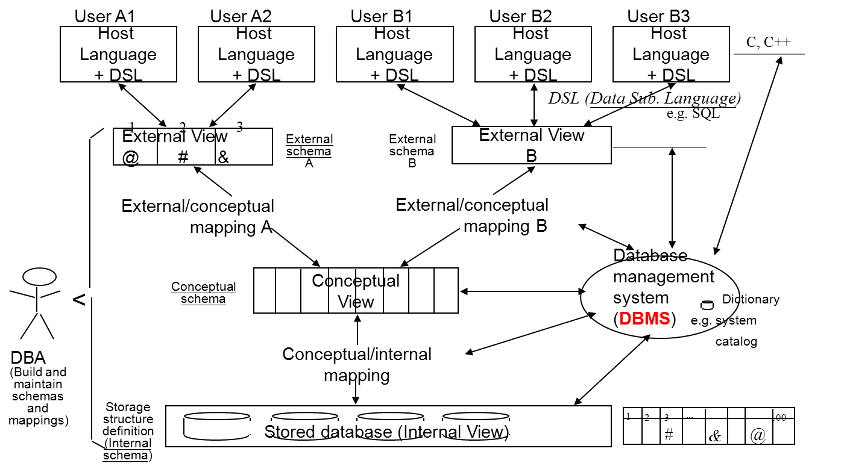
2.4 The System Catalog

Slide 34
System Catalog: Concept
cc record creator ...
S 4 5 Yang
P 5 6 Yang
SP 3 12 Yang
The Catalog Structure
SYSTABLES
SYSCOLUMNS
SYSINDEXES
System Catalog: "Data about data“ (Ref. p. 2-8)
i.e. information of base tables, view, indexes, users, and access privileges
that are of interest to the system itself.
Optimizer: use index info. to choose access method. (Ref. p. 2-9)
Authorization subsystem: use access privilege to grant or deny user requests.
Querying the catalog: by SQL DML
T1 T2 ...
u1 R R
u2 W R
un O W
access
control
matrix
.
.
.

Slide 35
Updating the Catalog
Cannot use the SQL update, delete and insert, because it would be too easy to destroy information!
It is data definition statements (i.e. CREATE, DROP, ALTER) that perform such updates.
CREATE = INSERT into catalog
DROP = DELETE from catalog
ALTER = UPDATE catalog

Slide 36
Updating the Catalog: Example
<e.g.>: CREATE TABLE S (S# CHAR(5) Not Null, SNAME CHAR(20) , STATUS SMALLINT, CITY CHAR(5);
SYSTABLE
SYSCOLUMNS
NAME CREATOR ...
NAME TBNAME ...
. . . . . . ...
. . . . . .
. . . . . . ...
. . . . . .
. . . . . . ...
. . . . . .
S
S# S
SNAME S
STATUS S
CITY S

Slide 37
Updating the Catalog: COMMENT
Catalog also includes entries for catalog tables.
SYSTABLE
NAME CREATOR . . . REMARK
SYSTABLE SYSIBM . . . . . .
SYSCOLUMN SYSIBM . . . . . .
. . . . . . . .
. . . . . . . .
S Yang . . . Supplier
P Yang . . . Part
SP Yang . . . . . .
The only statement that updates catalog: COMMENT
<e.g.>: COMMENT ON TABLE S IS Supplier

Slide 38
2.5 Embedded SQL

Slide 39
Embedded SQL: Dual-mode
Dual-mode principle: any SQL statement that can be used at terminal (interactive), can also be used in an application program (programmable).
PL/I (Record operations) vs. SQL (Set operations)
PL
SQL
call
:

Slide 40
Embedded SQL: a Fragment
<e.g.> Fragment of a PL/I program with embedded SQL
1 EXEC SQL BEGIN DECLARE SECTION ;
2 DCL SQLSTATE CHAR(5) ;
3 DCL P# CHAR(6) ;
4 DCL WEIGHT FIXED DECIMAL(3) ;
5 EXEC SQL END DECLARE SECTION ;
6 P# = ' P2 ' ; /* for example */
7 EXEC SQL SELECT P.WEIGHT
8 INTO :WEIGHT
9 FROM P
10 WHERE P. P# = :P# ;
11 IF SQLSTATE = ' 00000 '
12 THEN …. ; /* WEIGHT = retrieved value */
13 ELSE …. ; /* some exception occurred */

Slide 41
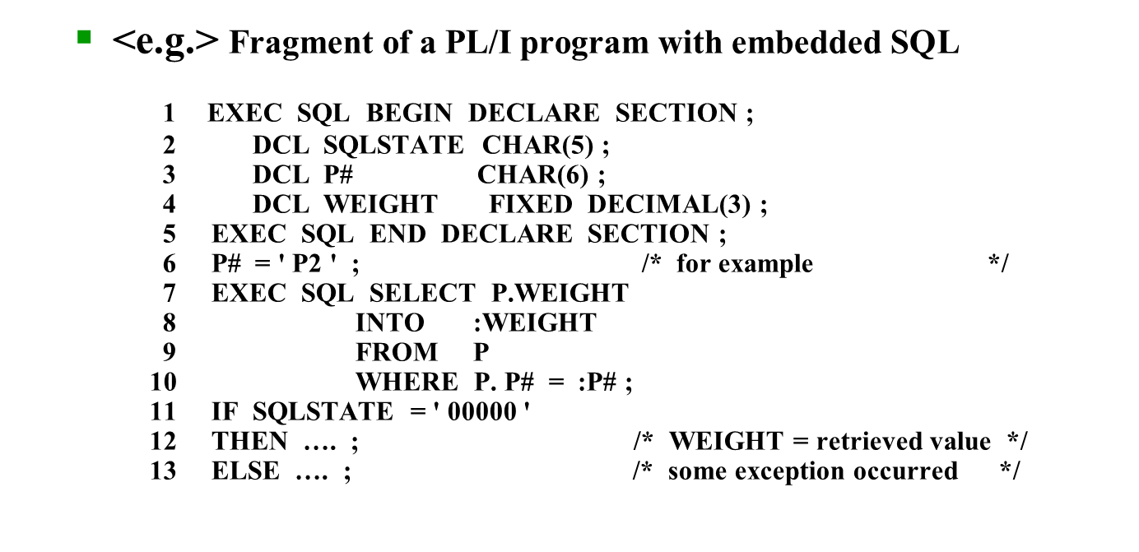
1. Embedded SQL statements are prefix by EXEC SQL.
2. Executable statements can appear wherever.
(non-executable statements: e.g. DECLARE TABLE, DECLARE CURSOR).
3. SQL statements can reference host variable. (PL/I var., :City)
4. Any table used should be declared by DECLARE TABLE, it is used by pre-compiler.

Slide 42
5. SQLSTATE/SQLCODE: feedback information of SQL, stored in SQLCA (SQL Communication Area).
SQLSTATE = 0 success
> 0 warning
< 0 error
6. Host variables must have compatible data type with SQL field.
7. Host variables can have same name as database fields.
SQLCA
SQLSTATE
or SQLCODE
e.g. City, :City
(SQL) (PL/I)

Slide 43
2.5.1 Operations
Singleton SELECT:
EXEC SQL SELECT STATUS INTO :RANK
FROM S
WHERE S#=: GIVENS#;
If only one record is satisfied: SQLCODE = 0
If no record is satisfied: SQLCODE > 0
If more than one record are satisfied: SQLCODE < 0
S
S# SNAME STATUS CITY
S1 Smith 20 London
S2 Jones 10 Paris
S3 Blake 30 Paris
S4 Clark 20 London
S5 Adams 30 Athens

Slide 44
Operation: Multiple SELECT
S
S# SNAME STATUS CITY
S1 Smith 20 London
S2 Jones 10 Paris
S3 Blake 30 Paris
S4 Clark 20 London
S5 Adams 30 Athens
EXEC SQL SELECT STATUS
FROM S
WHERE CITY=: GIVENCIT;
Multiple SELECT:
How to handle the cases that more than one record are satisfied?
Cursor

Slide 45
Cursor
S
S# SNAME STATUS CITY
S1 Smith 20 London
S2 Jones 10 Paris
S3 Blake 30 Paris
S4 Clark 20 London
S5 Adams 30 Athens
A kind of pointer that can be run through a set of records.
EXEC SQL DECLARE X CURSOR FOR /*define cursor S*/
SELECT S#, SNAME
FROM S
WHERE CITY =:Y;
EXEC SQL OPEN X; /*activate cursor, execute the query*/
DO for all S records accessible via X;
EXEC SQL FETCH X INTO :S#, :SNAME
.................. /*advance pt., assign values */
END;
EXEC SQL CLOSE X; /*deactivate cursor X*/
e.g. Y = 'London'
X
S#
SNAME
define cursor
open cursor
PL/I
close cursor
var
S#
S1
OPEN:
var
SNAME
X
S1 Smith
S4 Clark
Smith
S1 Smith
S4 Clark
FETCH:
X

Slide 46
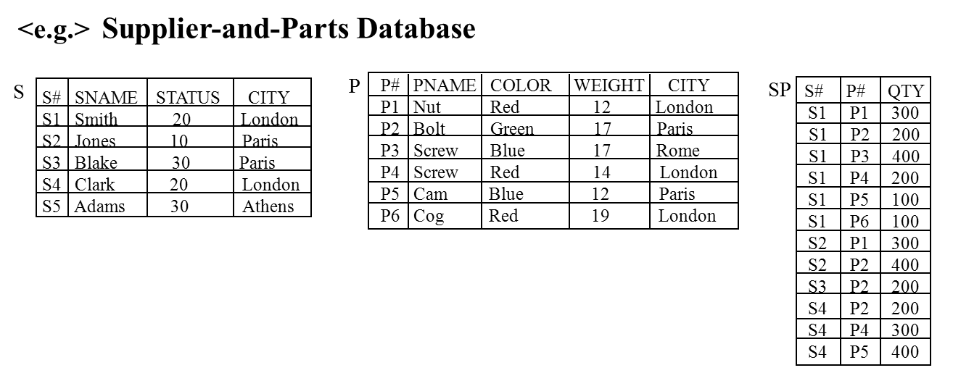
2.5.2 Embedded SQL: An Example
The program accepts four input values : a part number (GIVENP#), a city name (GIVENCIT), a status increment (GIVENINC), and a status level (GIVENLVL). The program scans all suppliers of the part identified by GIVENP#. For each such supplier, if the supplier city is GIVENCIT, then the status is increased by GIVENINC; otherwise, if the status is less than GIVENLVL, the supplier is deleted, together with all shipments for that supplier. In all cases supplier information is listed on the printer, with an indication of how that particular supplier was handled by the program.

Slide 47
Embedded SQL: An Example (cont.)
SQLEX: PROC OPTIONS (MAIN) ;
DCL GIVENP # CHAR(6) ;
DCL GIVENCIT CHAR(15) ;
DCL GIVENINC FIXED BINARY(15) ;
DCL GIVENLVL FIXED BINARY(15) ;
DCL S# CHAR(5) ;
DCL SNAME CHAR(20) ;
DCL STATUS FIXED BINARY(15) ;
DCL CITY CHAR(15) ;
DCL DISP CHAR(7) ;
DCL MORE_SUPPLIERS BIT(1) ;
EXEC SQL INCLUDE SQLCA ; /* p.2-41 */
EXEC SQL DECLARE S TABLE
( S# CHAR(5) NOT NULL,
SNAME CHAR(20) NOT NULL,
STATUS SMALLINT NOT NULL,
CITY CHAR(20) NOT NULL ) ;
EXEC SQL DECLARE SP TABLE
( S# CHAR(5) NOT NULL,
P# CHAR(6) NOT NULL,
QTY INTEGER NOT NULL ) ; Back 2-7
PL/I Var.

Slide 48
Embedded SQL: An Example (cont.)
EXEC SQL DECLARE Z CURSOR FOR
SELECT S#, SNAME, STATUS, CITY
FROM S
WHERE EXISTS
( SELECT *
FROM SP
WHERE SP. S# = S. S#
AND SP. P# = : GIVENP# ) i.e. P2
FOR UPDATE OF STATUS ;
EXEC SQL WHENEVER NOT FOUND CONTINUE ;
EXEC SQL WHENEVER SQLERROR CONTINUE ;
EXEC SQL WHENEVER SQLWARNING CONTINUE ;
ON CONDITION ( DBEXCEPTION )
BEGIN ;
PUT SKIP LIST ( SQLCA ) ;
EXEC SQL ROLLBACK ;
GO TO QUIT ;
END ;

Slide 49
Embedded SQL: An Example (cont.)
GET LIST ( GIVENP#, GIVENCIT, GIVENINC, GIVENLVL ) ;
EXEC SQL OPEN Z ;
IF SQLCODE < > 0 /* abnormal */
THEN SIGNAL CONDITION ( DBEXCEPTION ) ;
MORE_SUPPLIERS = ' 1' B ;
DO WHILE ( MORE_SUPPLIERS ) ;
EXEC SQL FETCH Z INTO :S#, :SNAME, :STATUS, :CITY ;
SELECT ; /* case */ /* a PL/I SELECT, not a SQL SELECT */
WHEN ( SQLCODE = 100 ) /* Not found */
MORE_SUPPLIERS = ' 0 ' B ;
WHEN ( SQLCODE < > 100 & SQLCODE < > 0 ) /* Warning */
SIGNAL CONDITION ( DBEXCEPTION ) ;
Main
SQLCODE =0

Slide 50
Embedded SQL: An Example (cont.)
WHEN ( SQLCODE = 0 ) /* success */
DO ;
DISP = ' bbbbbbb ' ; /* empty the display buffer */
IF CITY = GIVENCIT
THEN
DO ;
EXEC SQL UPDATE S
SET STATUS = STATUS + : GIVENINC;
WHERE CURRENT OF Z ;
IF SQLCODE < > 0
THEN SIGNAL CONDITION ( DBEXCEPTION ) ;
DISP = ' UPDATED ' ;
END ;
ELSE
IF STATUS < GIVENLVL
THEN
DO ;
EXEC SQL DELETE
FROM SP
WHERE S# = : S# ;

Slide 51
Embedded SQL: An Example (cont.)
IF SQLCODE < > 0 & SQLCODE < > 100
THEN SIGNAL CONDITION ( DBEXCEPTION );
EXEC SQL DELETE
FROM S
WHERE CURRENT OF Z ;
IF SQLCODE < > 0
THEN SIGNAL CONDITION ( DBEXCEPTION);
DISP = 'DELETED ' ;
END ;
PUT SKIP LIST ( S#, SNAME, STATUS, CITY, DISP ) ;
END ; /* WHEN ( SQLCODE = 0 ) */
END ; /* PL/I SELECT */
END ; /* DO WHILE */
EXEC SQL CLOSE Z ;
EXEC SQL COMMIT ; /* normal termination */
QUIT: RETURN ;
END ; /* SQLEX */

Slide 52
2.6 實作及範例

Slide 53
Program Exercise 1: Using DBMS (EX1:usingSQL)
EX. 4.1-4.6 (p.99-100)
Using the suppliers-parts-projects database, write a program with
embedded SQL statements to list all supplier rows, in supplier number
order. Each supplier row should be immediately followed in the listing by
all project rows for projects supplied by that supplier, in project number
order.
create database
selection
update
query catalog
.
.
.
embedded SQL (program)

Slide 54
下載安裝WampSever(含MySQL)
建立使用環境:下載安裝WampSever
WampServer 是一個整合了 Apache (網站伺服器)、MySQL (資料庫系統)、和 PHP 的套件，即安裝一次 WampServer，就同時安裝完成上述軟體。
我們就是資料庫網站開發人員
可在自己的桌面電腦上編寫和測試程式，無須檔案上傳到伺服器，可以節省很多時間；
程式錯誤不會破壞伺服器，若有差錯，也只是在自已的電腦的某一個資料夾，絕不會影響伺服器上的其他系統。
點選影音檔 Ex1:下載安裝WampSever (含MySQL) [助教說明]
點選影音檔 Ex1:下載安裝WampSever (含MySQL) [吳嘉峰同學範例說明]

Slide 55
透過 phpMyAdmin 操作MySQL
透過 phpMyAdmin 操作MySQL
phpMyAdmin 是一個以PHP為基礎，以Web-Base方式架構在網站主機上的MySQL的資料庫管理工具，讓管理者可用Web介面管理MySQL資料庫。
由此Web介面可以簡易方式輸入SQL語法並顯示結果。
phpMyaAdmin跟其他PHP程式一樣在網頁伺服器上執行，可以在任何地方使用這些程式產生的HTML頁面，也就是可以遠端管理MySQL資料庫，即可以方便的建立、修改、刪除資料庫及資料表。
參考說明與範例
點選影音檔 Ex1:透過 phpMyAdmin 操作MySQL [助教說明]
點選影音檔 Ex1:透過 phpMyAdmin 操作MySQL [吳嘉峰同學範例說明]
參考點選更多的範例說明

